Slide 1
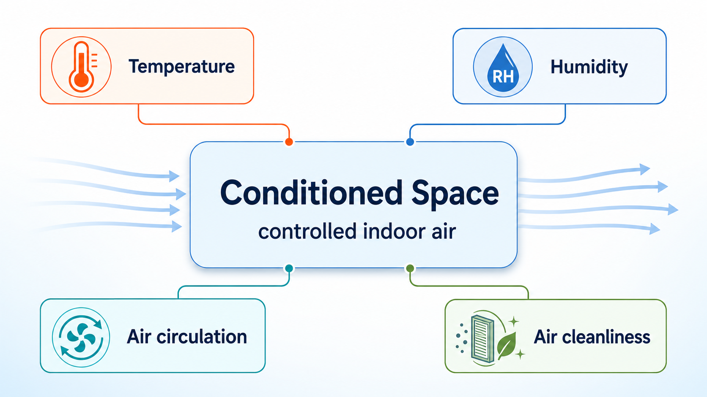
AIR CONDITIONING · CHAPTER 1
1.1 Air Conditioning
Definition, Purpose, and Scope
Air conditioning is not simply cooling. It is the simultaneous control of the indoor environment.
Temperature
Humidity
Air circulation
Air cleanliness
Teaching focus: cooling-mode AC for Thailand
Air Conditioning · Chapter 1 · Topic 1.1
1

Slide 2
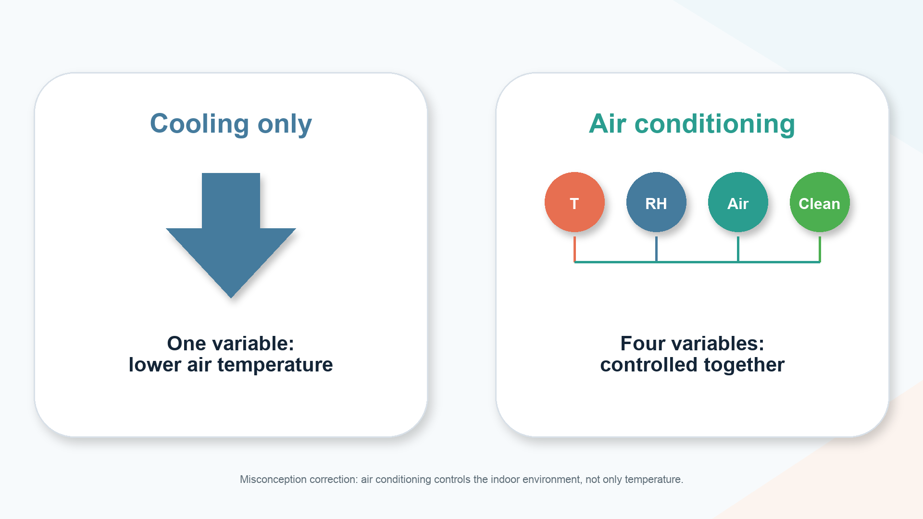
1.1 | Cooling only is not air conditioning
Start with the misconception and correct it visually.
Air Conditioning · Chapter 1 · Topic 1.1
2

Slide 3
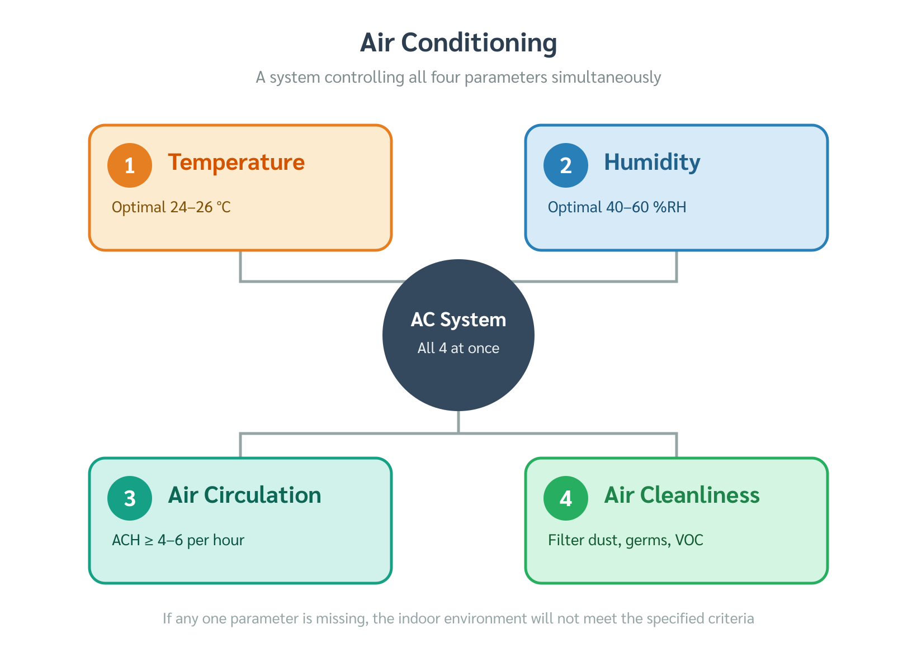
Four parameters must be controlled together
3
Use the 2×2 visual as the core definition.
CORE DEFINITION
Control these together
1
Temperature
sensible heat balance
2
Humidity
latent moisture control
3
Air circulation
mixing + distribution
4
Air cleanliness
filtration + dilution
Air Conditioning · Chapter 1 · Topic 1.1
3

Slide 4
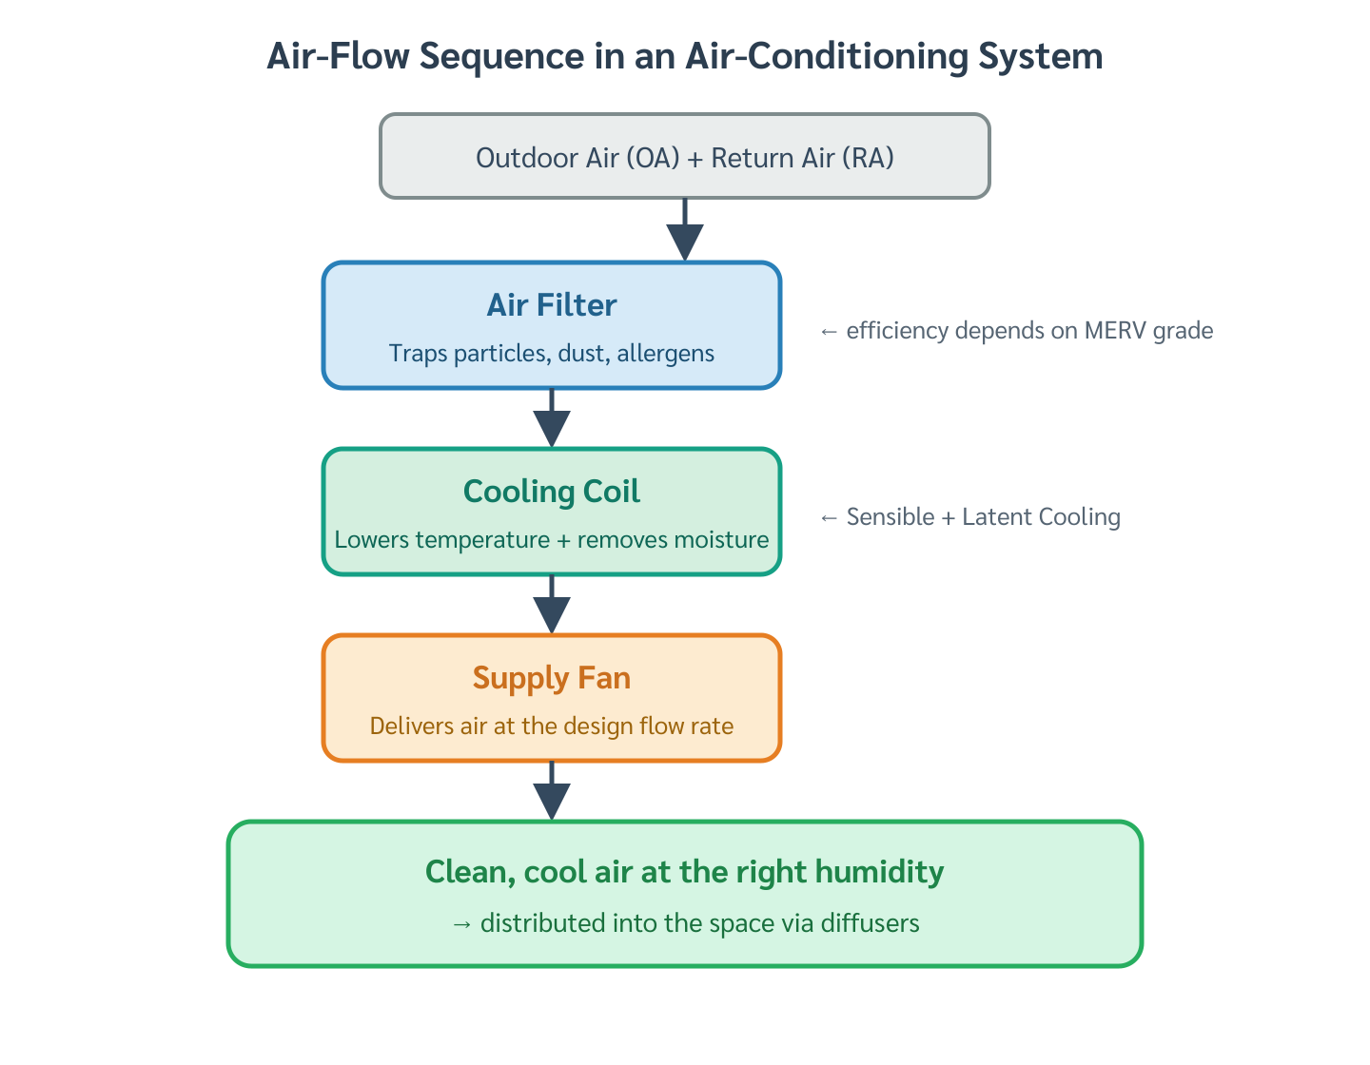
If one control fails, the whole environment can fail
4
A good temperature reading does not guarantee a good indoor environment.
WHY IT MATTERS
One weak control can ruin comfort
1
Sticky at 25 °C
humidity is still too high
2
Stale or smelly air
ventilation/cleanliness is weak
3
Uneven room comfort
poor air distribution
Air Conditioning · Chapter 1 · Topic 1.1
4

Slide 5
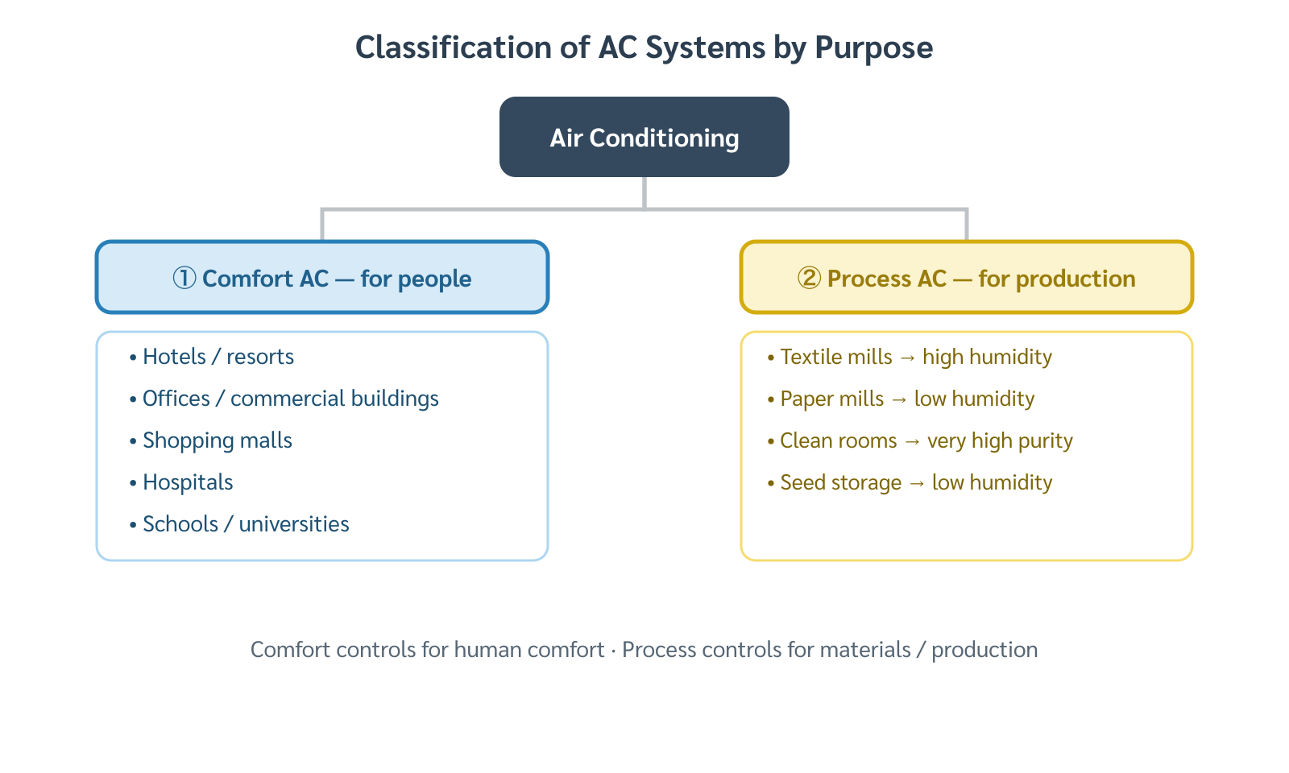
Purpose changes the design target
5
Comfort AC and process AC use the same variables for different goals.
DESIGN TARGET
Purpose changes the setpoint
1
Comfort AC
human thermal comfort
2
Process AC
product, material, or process requirement
Air Conditioning · Chapter 1 · Topic 1.1
5

Slide 6
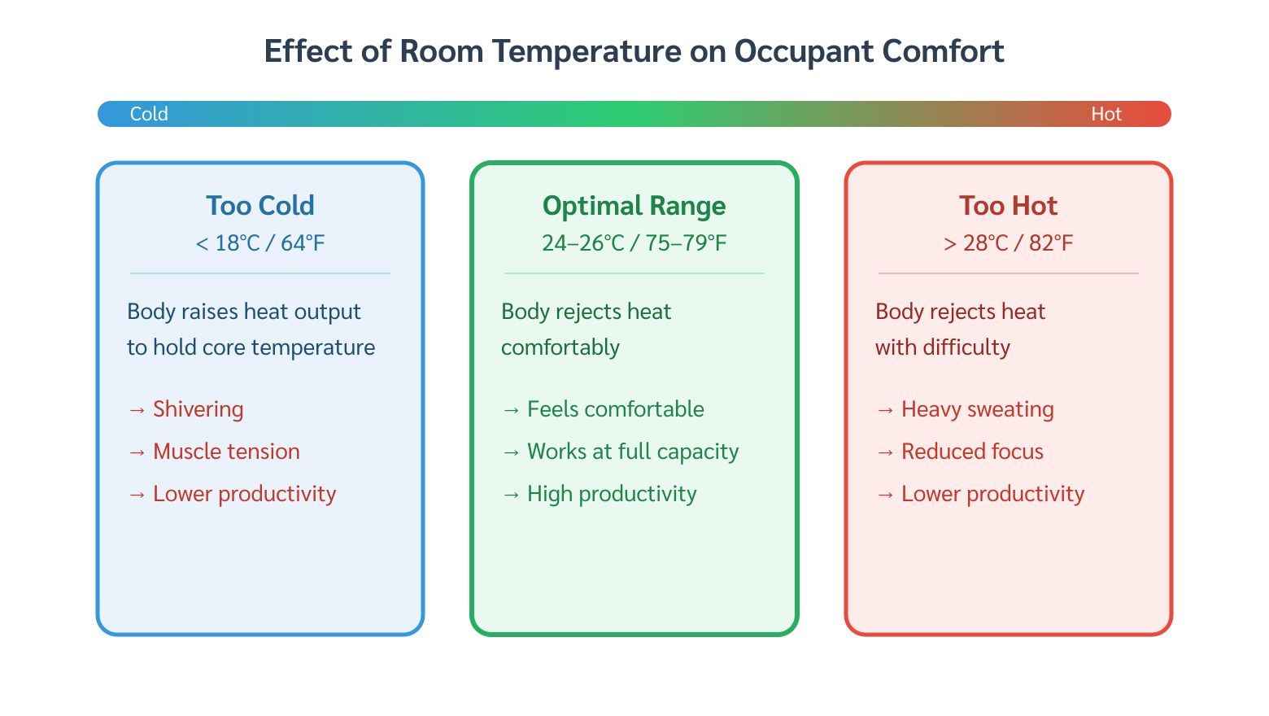
Comfort AC supports the body’s heat balance
6
Use the human body as the “sensor” for comfort air conditioning.
COMFORT MECHANISMS
The body is the sensor
1
Convection
heat transfer to moving air
2
Radiation
exchange with surfaces
3
Conduction
contact with materials
4
Evaporation
sweat + moisture removal
Air Conditioning · Chapter 1 · Topic 1.1
6

Slide 7
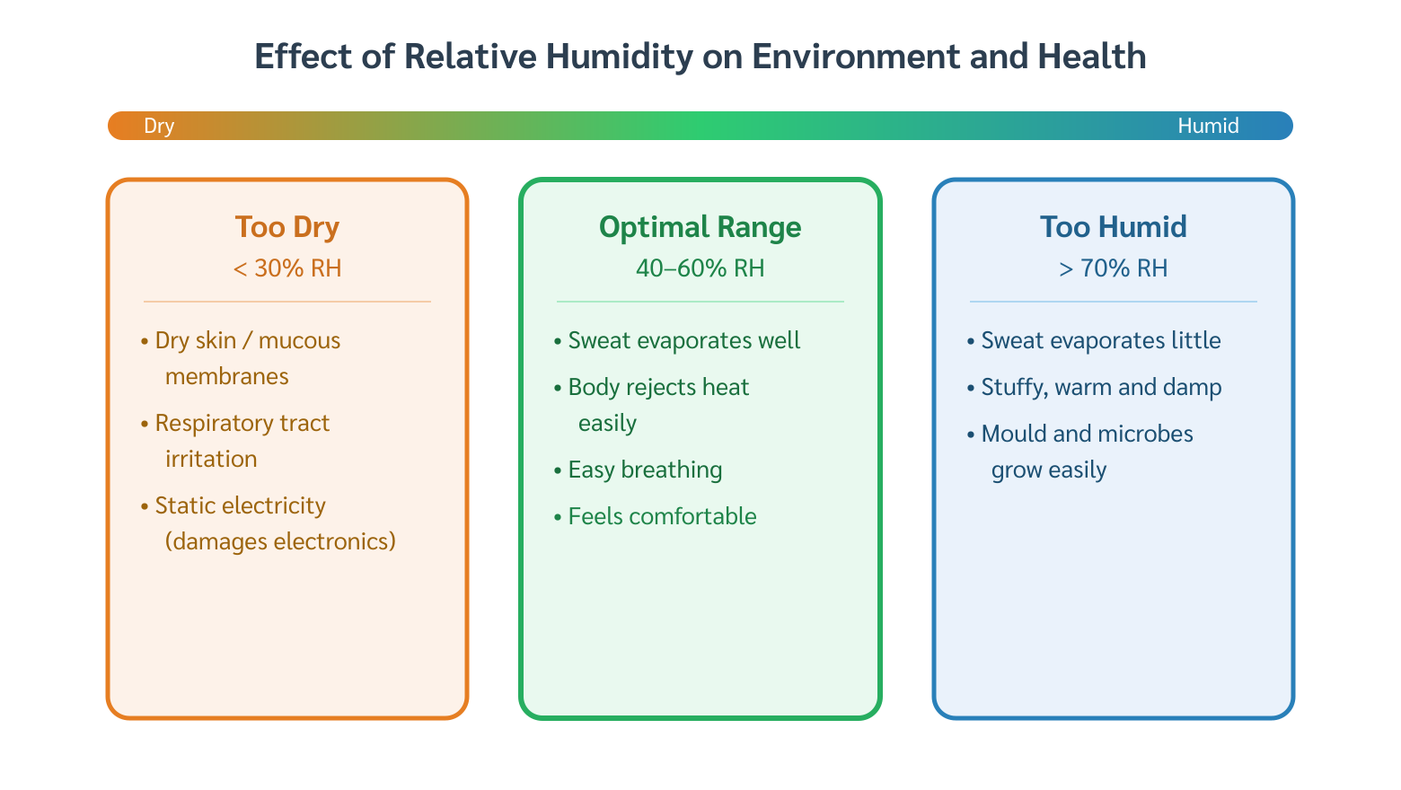
Process AC may target conditions humans would not choose
7
Let the product/process define the control objective.
PROCESS EXAMPLES
The product defines comfort
1
Textile mill
higher RH for fibers
2
Paper storage
lower RH to protect stock
3
Seed storage
low temperature + low humidity
Air Conditioning · Chapter 1 · Topic 1.1
7

Slide 8
Equipment sizing is a peak-load problem
8
Capacity must match the maximum heat gain rate during operation.
SIZING PRINCIPLE
Peak load sets capacity
Peak
Design for maximum expected load
not the daily average
Average load can be misleading
capacity may be undersized
Avg
Time of day →
Air Conditioning · Chapter 1 · Topic 1.1
8

Slide 9
Office peak load often occurs after solar noon
9
Stored heat and internal gains shift the maximum into mid-afternoon.
Load
Peak around 15:00–16:00
solar + thermal lag + internal gains
Peak follows use pattern
08:00
12:00
16:00
20:00
Air Conditioning · Chapter 1 · Topic 1.1
9

Slide 10
Nightclub peak load is driven by people and lighting
10
A building with little solar gain can peak at night.
Load
Peak around 21:00–22:00
occupants + lighting + latent heat
Peak follows use pattern
18:00
20:00
22:00
24:00
Air Conditioning · Chapter 1 · Topic 1.1
10

Slide 11
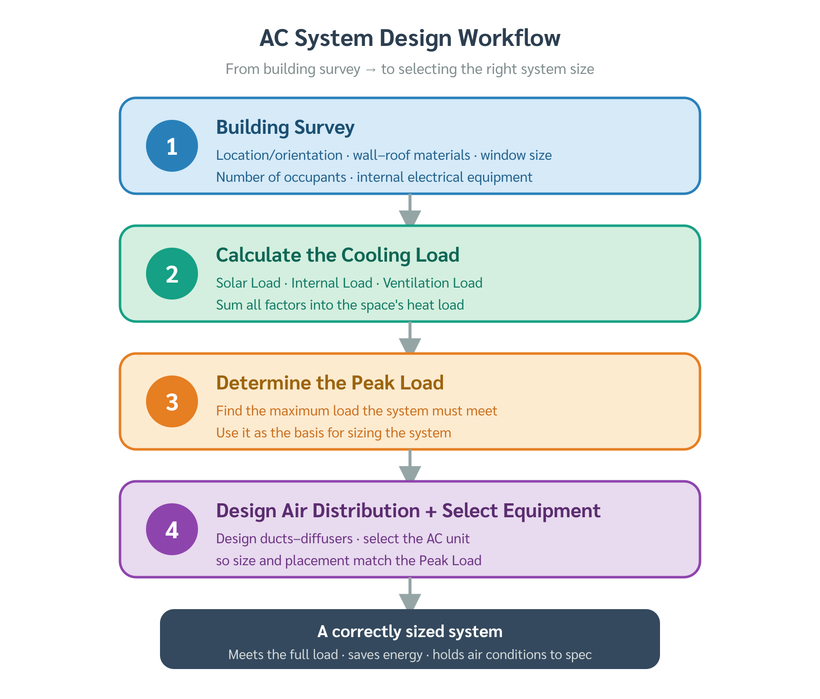
A building survey turns assumptions into inputs
11
The survey is the first engineering step before load calculation.
FIRST ENGINEERING STEP
Survey before calculating
1
Measure
room size and envelope data
2
Collect
loads, schedules, ventilation needs
3
Verify
reduce over/under-sizing risk
Air Conditioning · Chapter 1 · Topic 1.1
11

Slide 12
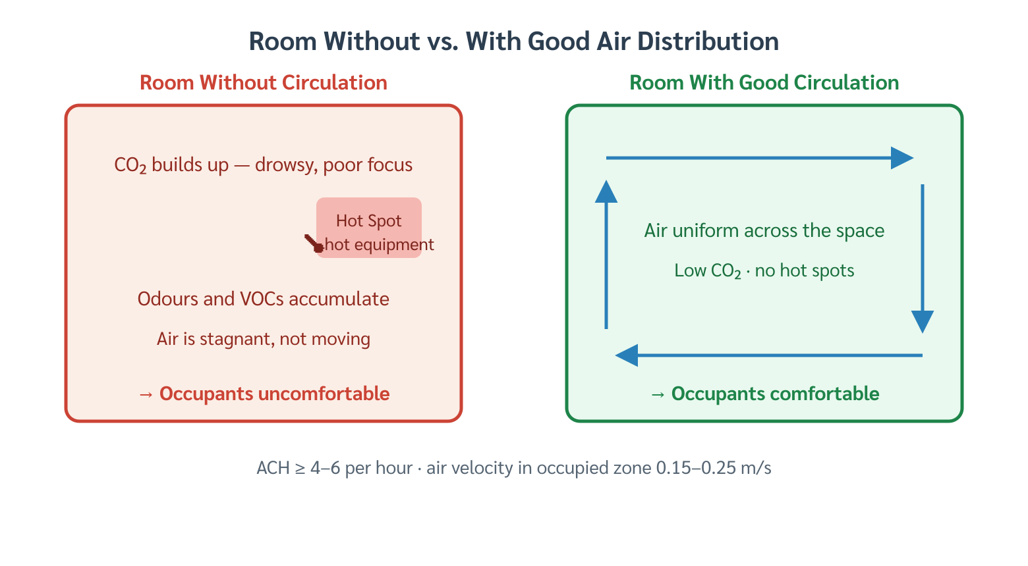
What must be surveyed?
12
Organize inputs into external and internal data.
SURVEY CHECKLIST
External + internal inputs
1
External data
location, orientation, solar exposure, shading
2
Internal data
room size, occupancy, lighting, equipment, schedule
Air Conditioning · Chapter 1 · Topic 1.1
12

Slide 13
This course focuses on cooling-mode AC in Thailand
13
Scope the course so students know what is included and excluded.
Thailand design context
☀
High outdoor temperature
RH
High humidity
AC
Cooling + dehumidification
sensible load
latent load
main course scope
Heating and humidification are not the main focus for this course.
Air Conditioning · Chapter 1 · Topic 1.1
13

Slide 14
Pause question: which parameter controls the problem?
14
Use this as an interactive slide before summarizing.
A classroom is 25 °C, but students feel sticky.
Which parameter is likely the problem?
Temperature
Humidity
Air motion
Cleanliness
Expected answer: humidity and/or air movement.
Air Conditioning · Chapter 1 · Topic 1.1
14

Slide 15
Topic 1.1 — what students should remember
15
1
2
3
AC = simultaneous control
Purpose defines target
Survey before design
Temperature + humidity + circulation + cleanliness
Comfort for people or process conditions for materials
Survey data become load-calculation inputs
Air Conditioning · Chapter 1 · Topic 1.1
15

